Slide 1

RECURRENT NEURAL NETWORKS The Unreasonable Effectiveness

Slide 2
Why do we need RNNs ?
Let’s try to understand with an example that why some problems can’t be solved using MLPs.

Slide 3
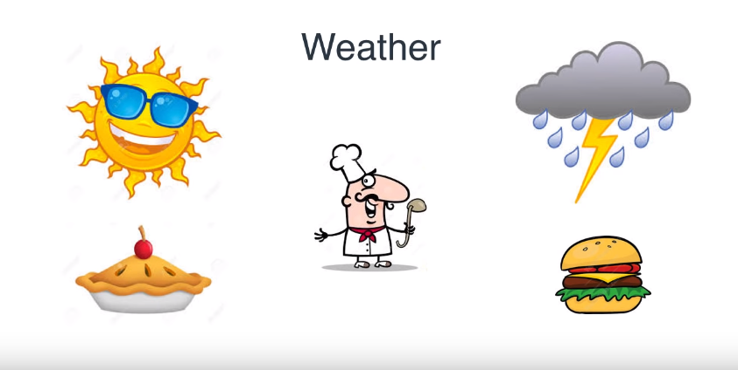
The Chef Problem (MLP)
Weather | Food Cooked
Sunny | Pie
Rainy | Burger

Slide 4
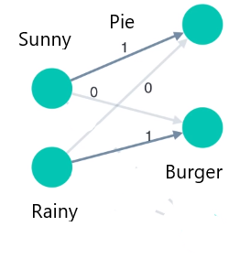
The problem can be solved by using a simple neural network where:
Input Layer denotes Weather
Output Layer denotes Food Cooked

Slide 5
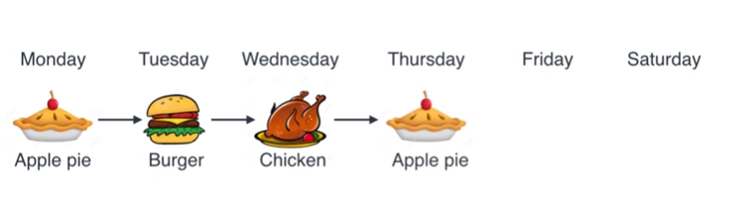
The Chef Problem (RNN)
Input | Output
Pie | Burger
Burger | Chicken
Chicken | Pie

Slide 6
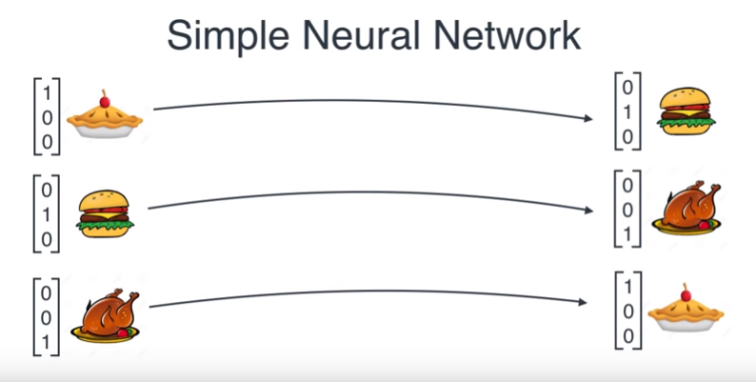

Slide 7
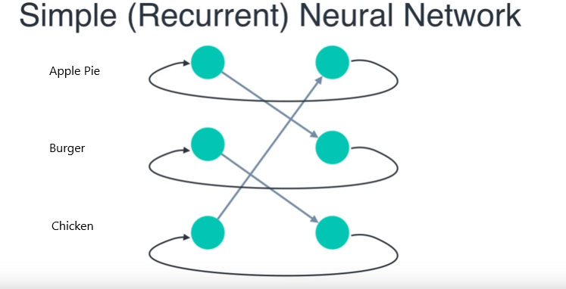

Slide 8
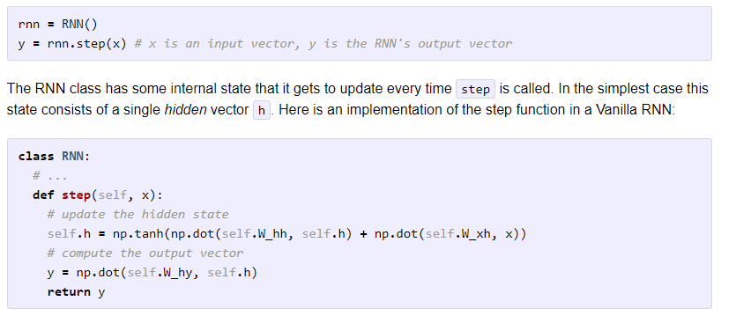

Slide 9
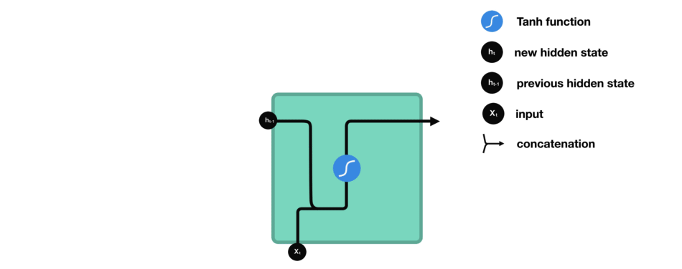
RNN Block

Slide 10
Character Language Models
Given a sequence of characters as input the RNN tries to predict the next character in the output.
For instance if our input sequence = “hello”
So the sequence contains only 4 characters ‘h’,’e’,’l’,’o’
So the size of vocabulary would be only 4.

Slide 11
Training Process
Model should understand the difference in contexts
Time | Input | Output
T = 0 | “h” | Predict ‘e’
T = 1 | “he” | Predict ‘l’
T = 2 | “hel” | Predict ‘l’
T = 3 | “hell” | Predict ‘o’

Slide 12
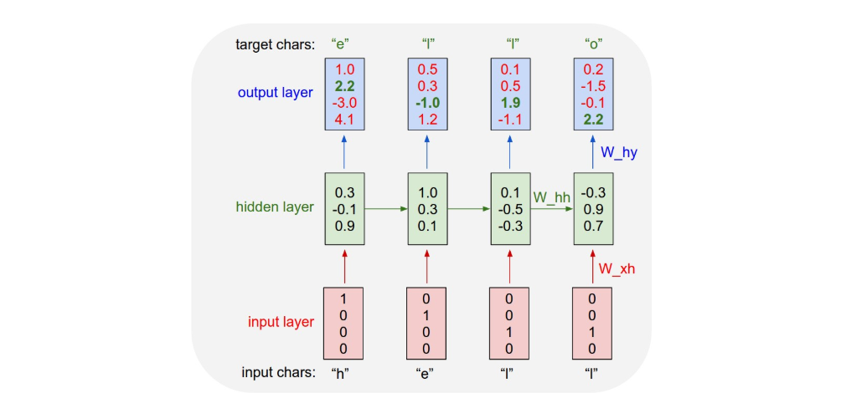
Model Representation

Slide 13
Advanced RNN Models
GRU
LSTM

Slide 14
The Vanishing Gradient Problem
As more layers using certain activation functions are added to neural networks, the gradients of the loss function approaches zero, making the network hard to train.
If n hidden layer use activation functions like sigmoid, n small derivatives multiplied by chain rule to calculate derivative of initial layers.

Slide 15
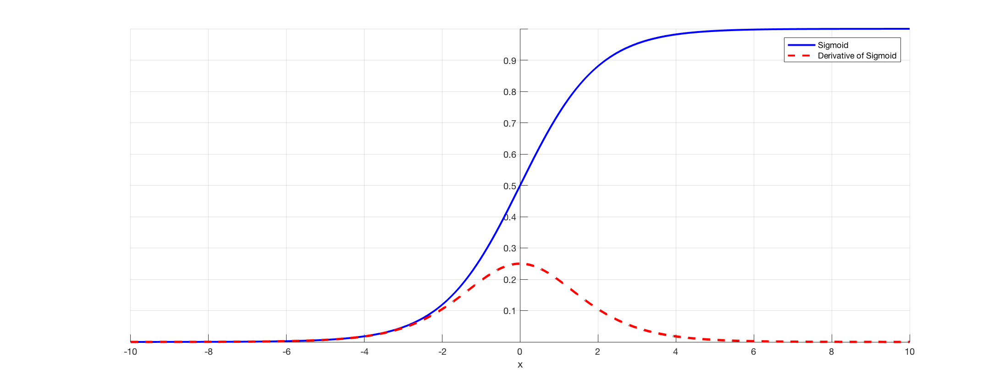

Slide 16
Gated Recurrent Unit (GRU)
Solve Vanishing Gradient
Update Gates
Reset Gates

Slide 17
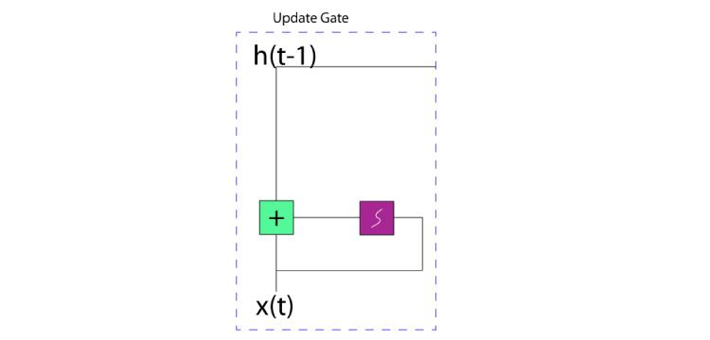
Update Gate
Update Gate helps the model to determine how much past information should be let through to future time steps
z(t) = sig( W(z)x(t) + U(z)h(t-1) )

Slide 18
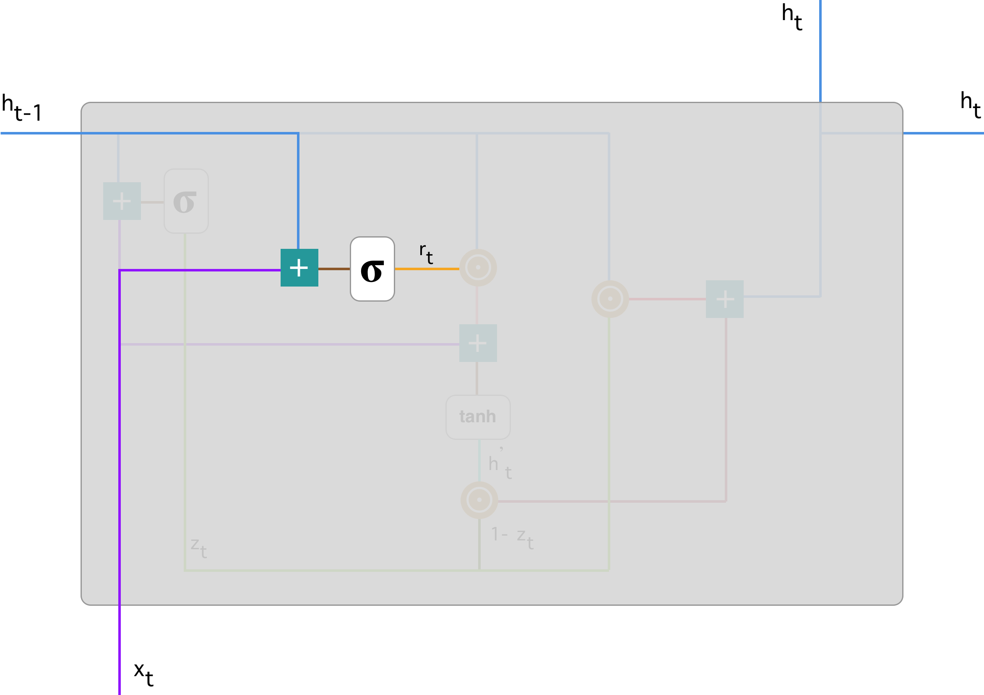
Reset Gate
Reset Gate helps the model to determine how much past information should be forget to future time steps
r(t)=sig(W(r)x(t)+U(r)h(t-1)

Slide 19
Current Memory Content
A memory content that stores relevant information from the past using reset gate
h(t)’ = tanh( W(h’)x(t) + r(t)U(h’)h(t-1) )

Slide 20
Final Memory
Calculating information for current time step using update gate
Decides what to store from current memory content and what from memory of previous steps
h(t) = z(t) * h(t-1) + (1-z(t)) * h(t)’

Slide 21
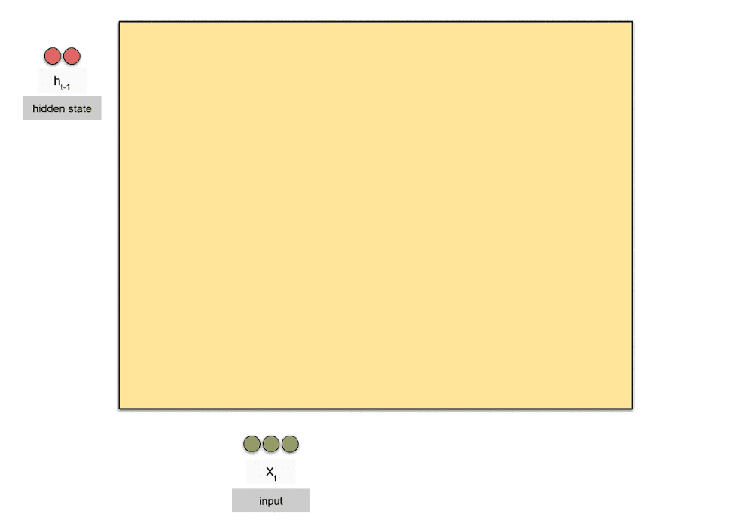
GRU Block

Slide 22
Long Short Term Memory
The LSTM model has 2 additional gates
Forget Gate
Output Gate
Unlike GRU, it does not have a Reset Gate
Unlike GRUs, the output of the LSTM is not the same as the cell state

Slide 23
Forget Gate
The forget gate decides how much of the previous information is to be forgotten.
It is used in place of ( 1- Update gate ) that is used in GRU
f(t) = sig( W(f)[x(t),h(t-1)] )
Where h(t-1) is the output of the previous layer

Slide 24
Output Gate
The output of an LSTM cell is not the same as the cell state
The output gate is used to compute the output for LSTM
o(t) = sig( W(o)[x(t), h(t-1)] )
Where h(t-1) is the output of previous cell

Slide 25
Output of LSTM
The final cell state of the LSTM cell:
c(t) = z(t) * c(t)’ + f(t) * c(t-1)
Where z(t) is the update gate and c(t)’ is the candidate cell state
The output of LSTM:
h(t) = o(t) * tanh(c(t))

Slide 26

LSTM Block

Slide 27
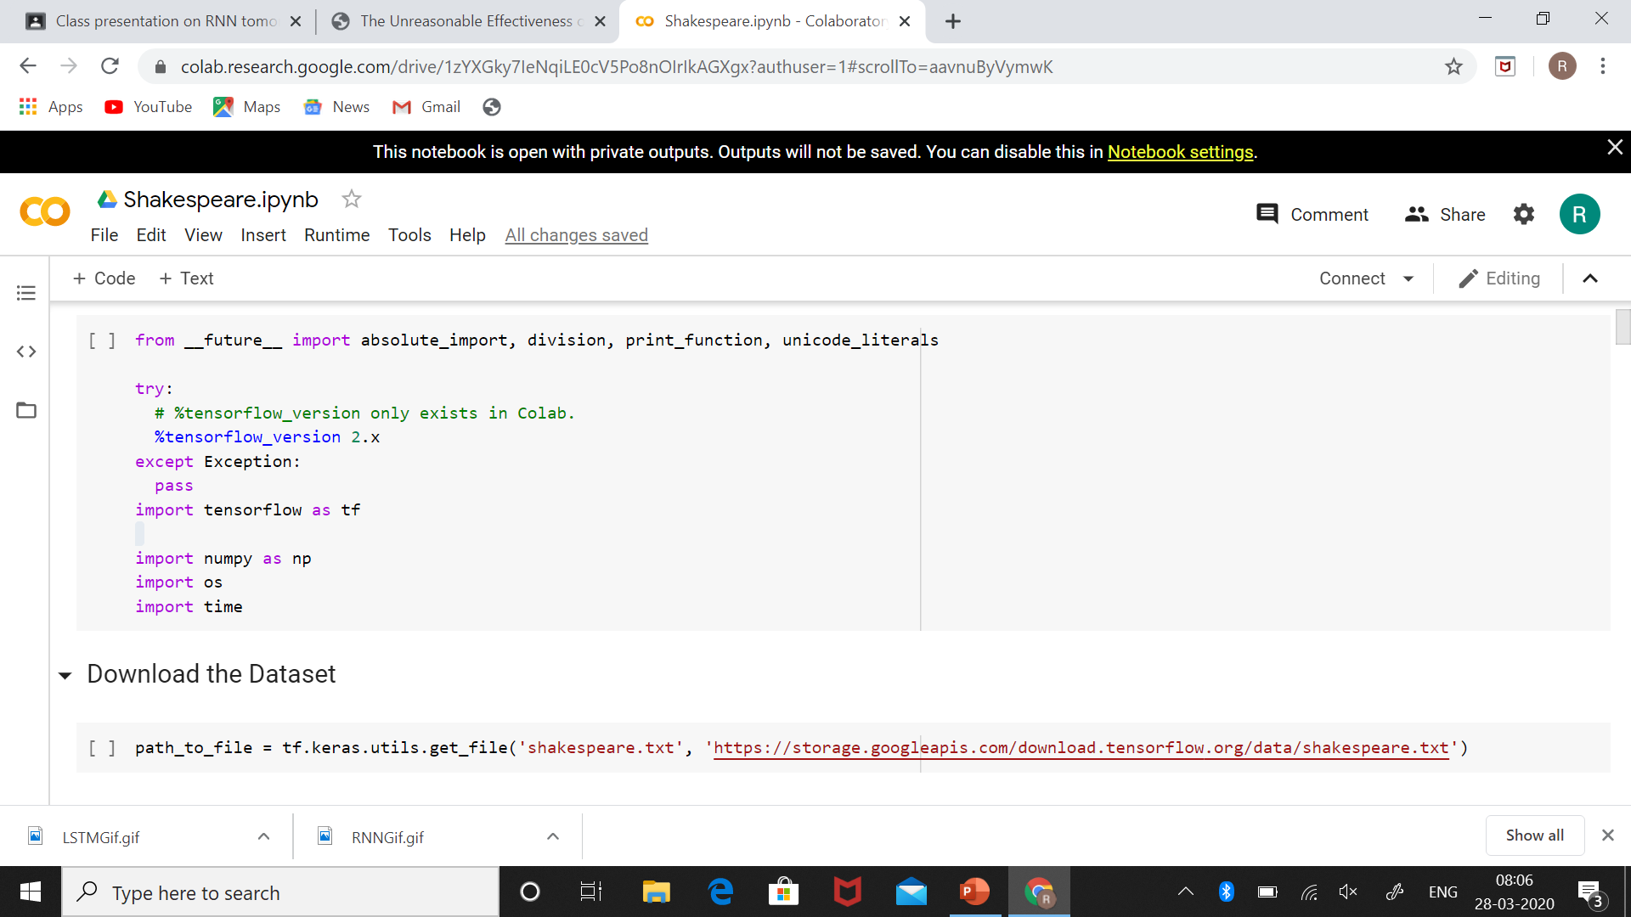
The Code

Slide 28
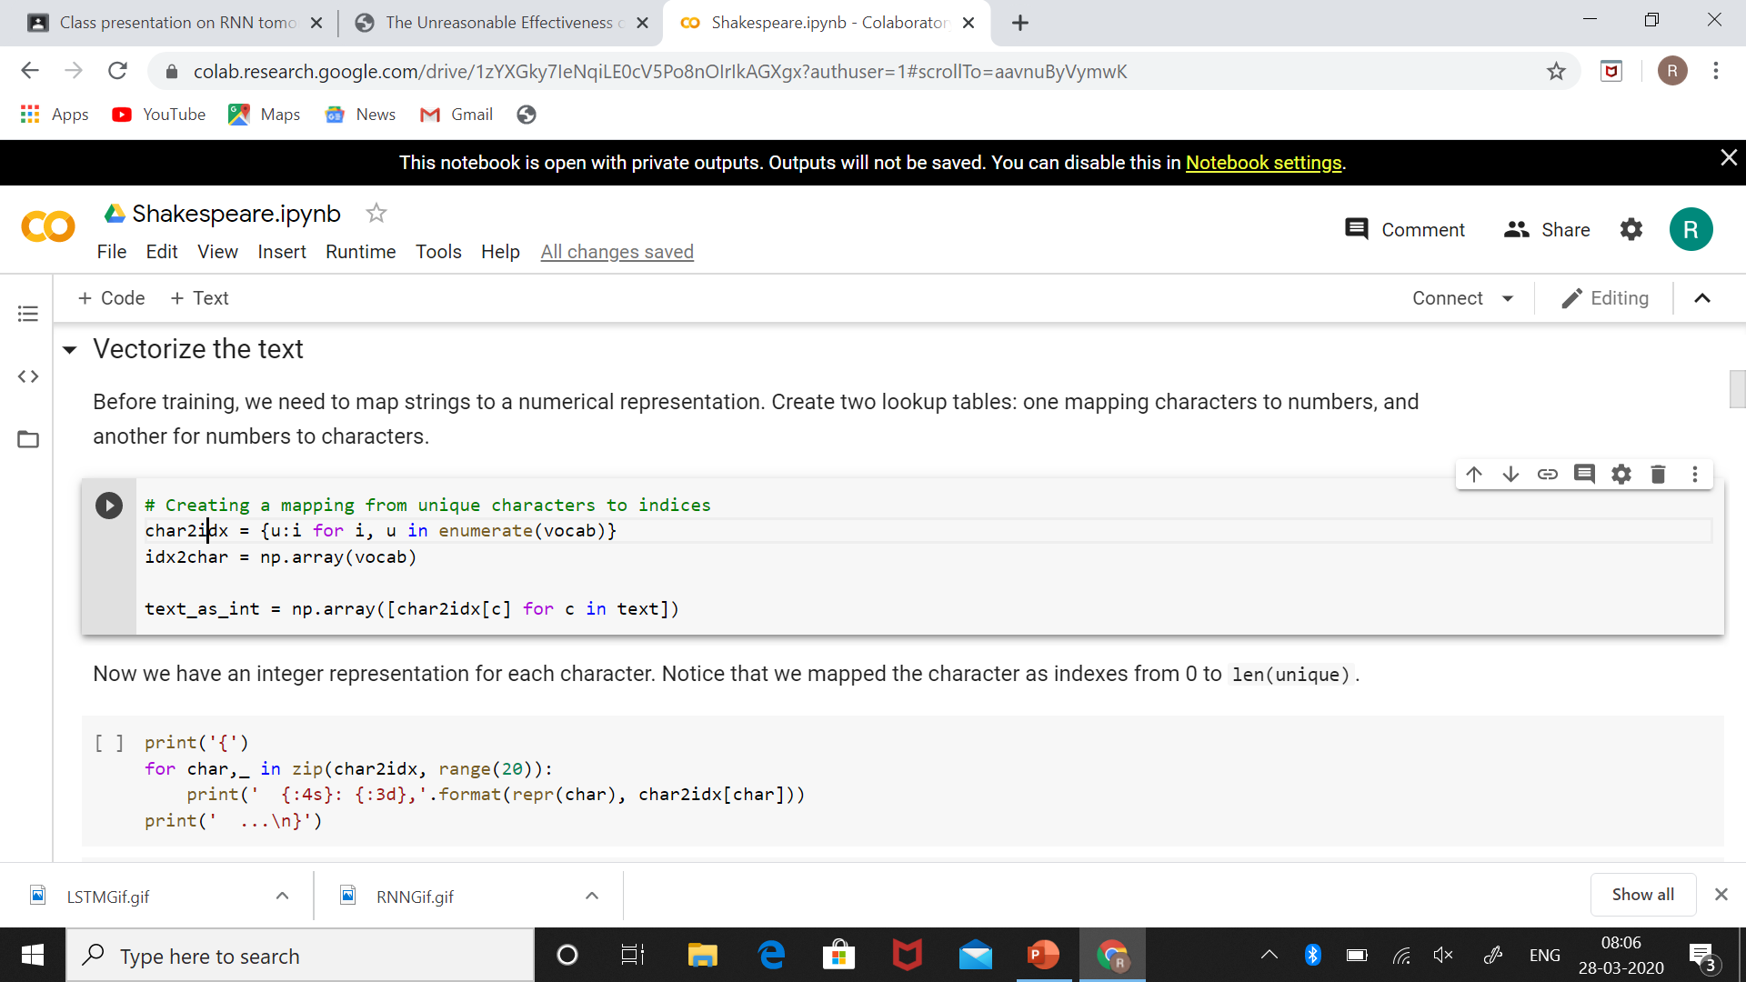
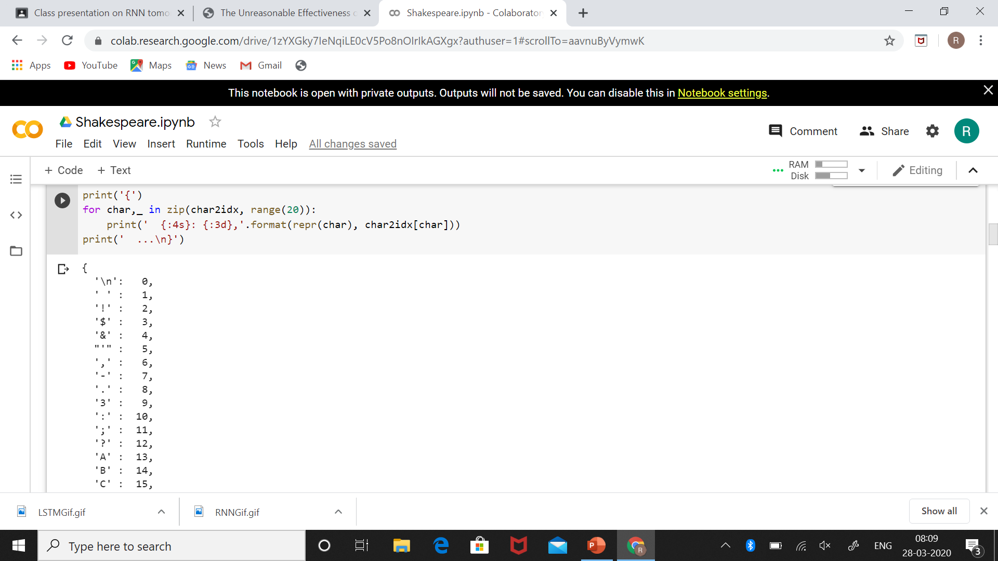

Slide 29
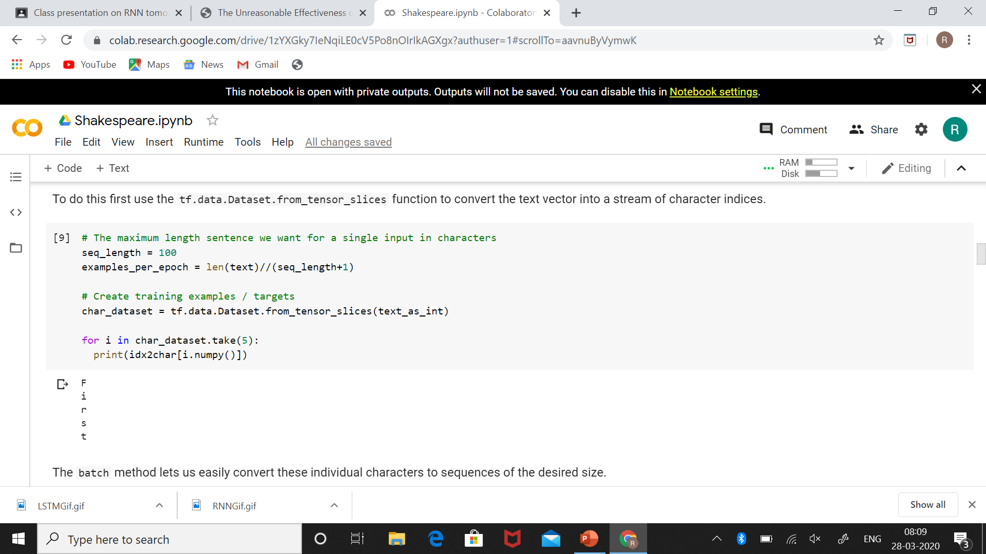
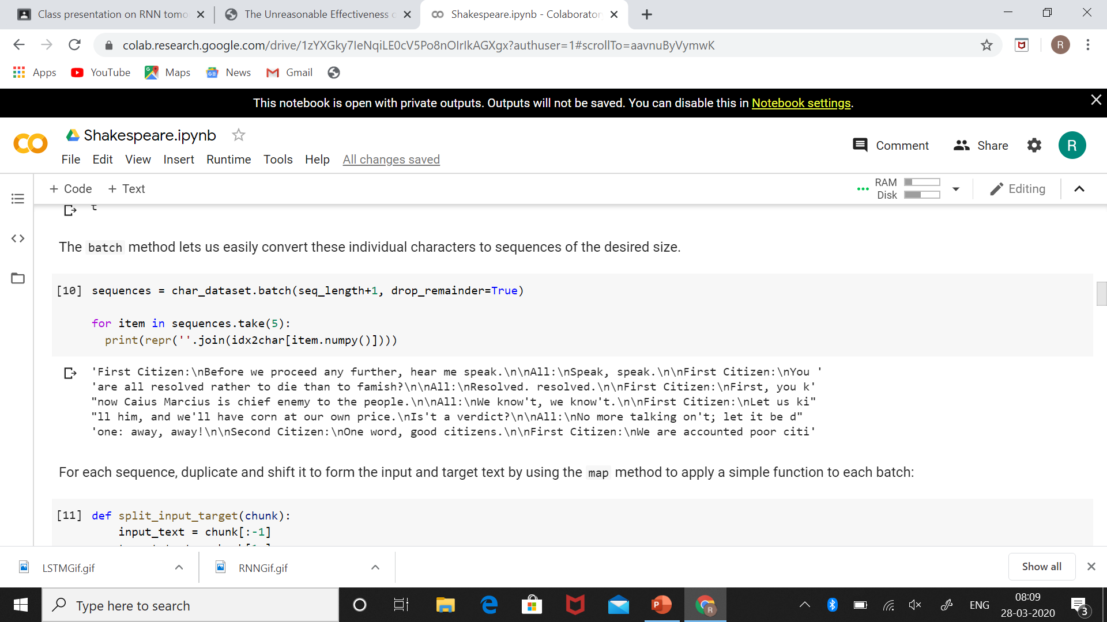

Slide 30
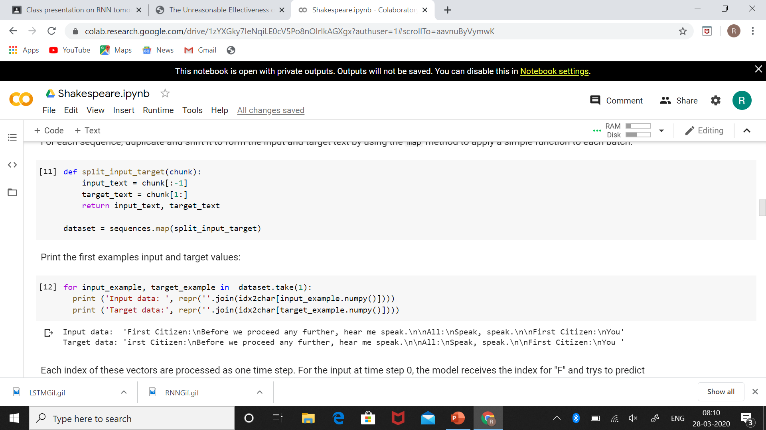
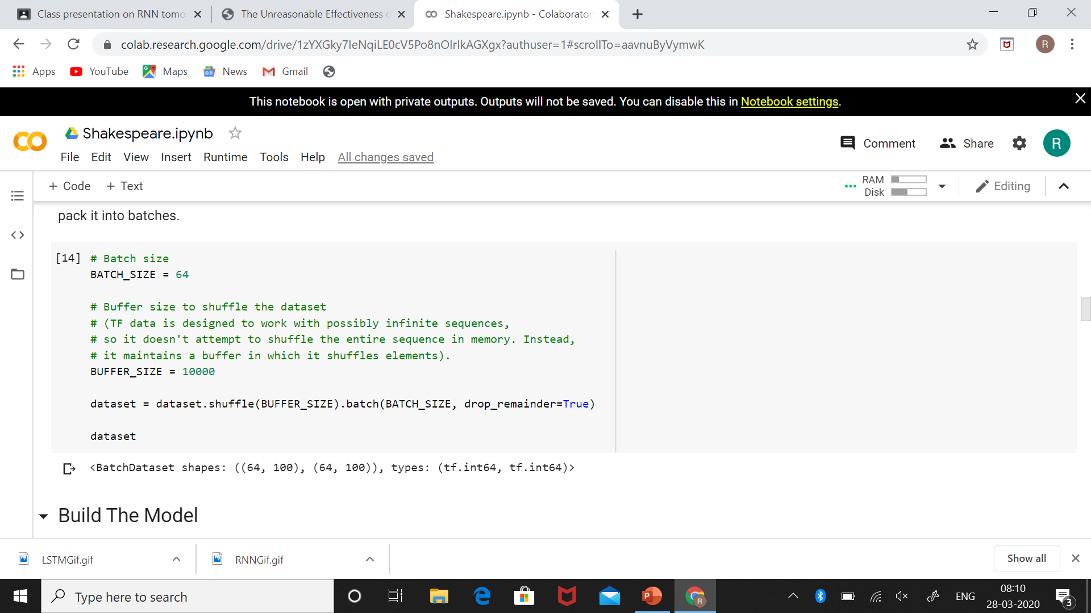

Slide 31
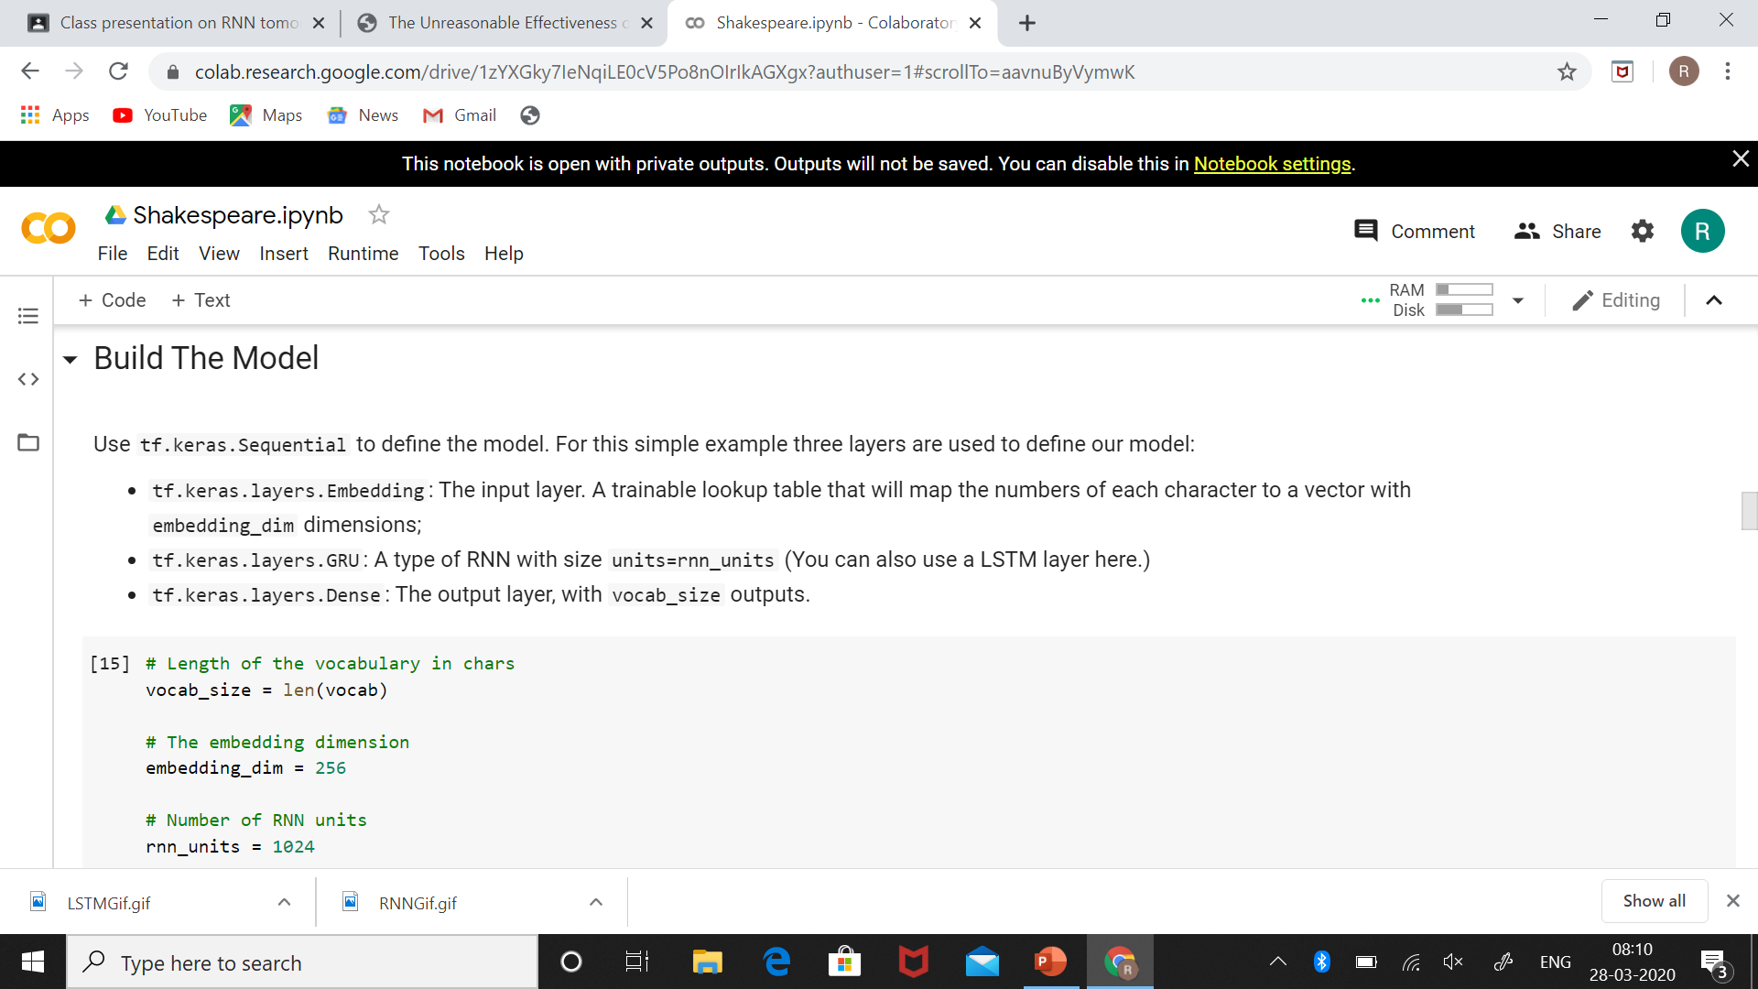
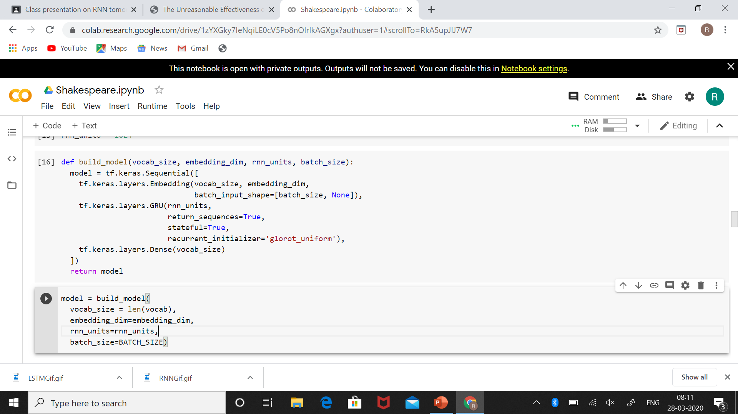

Slide 32
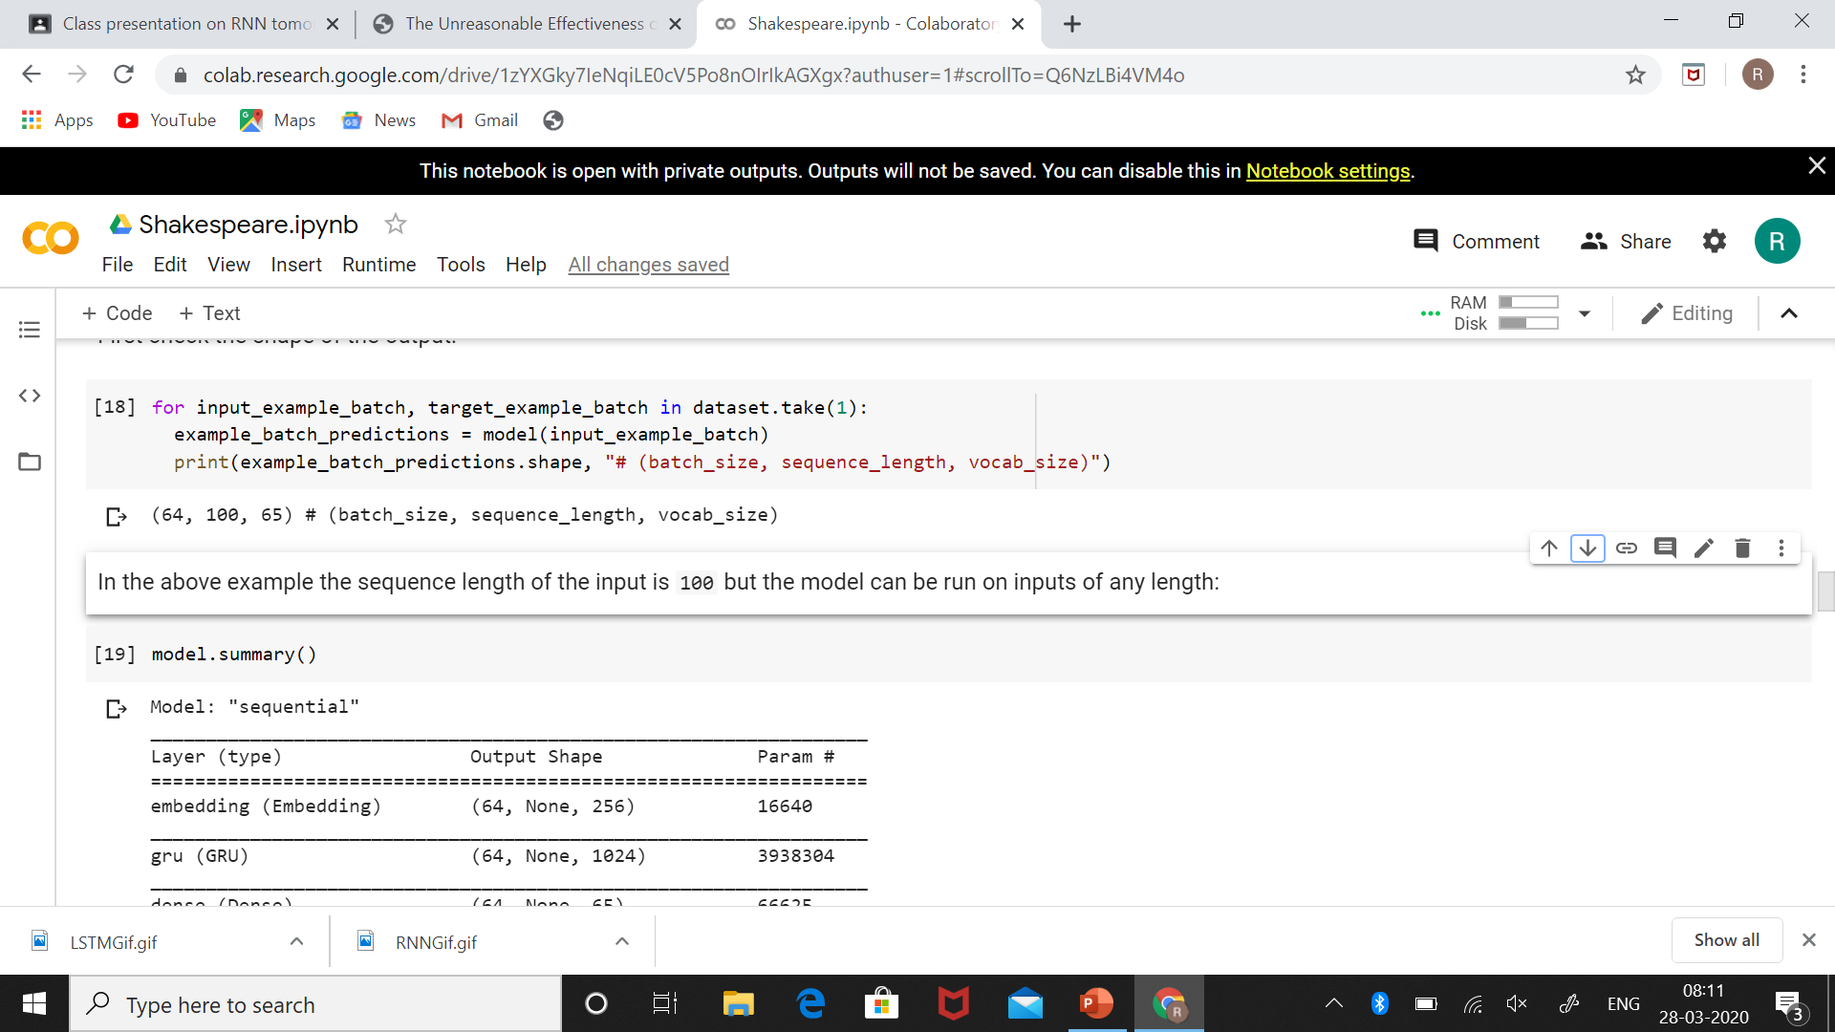
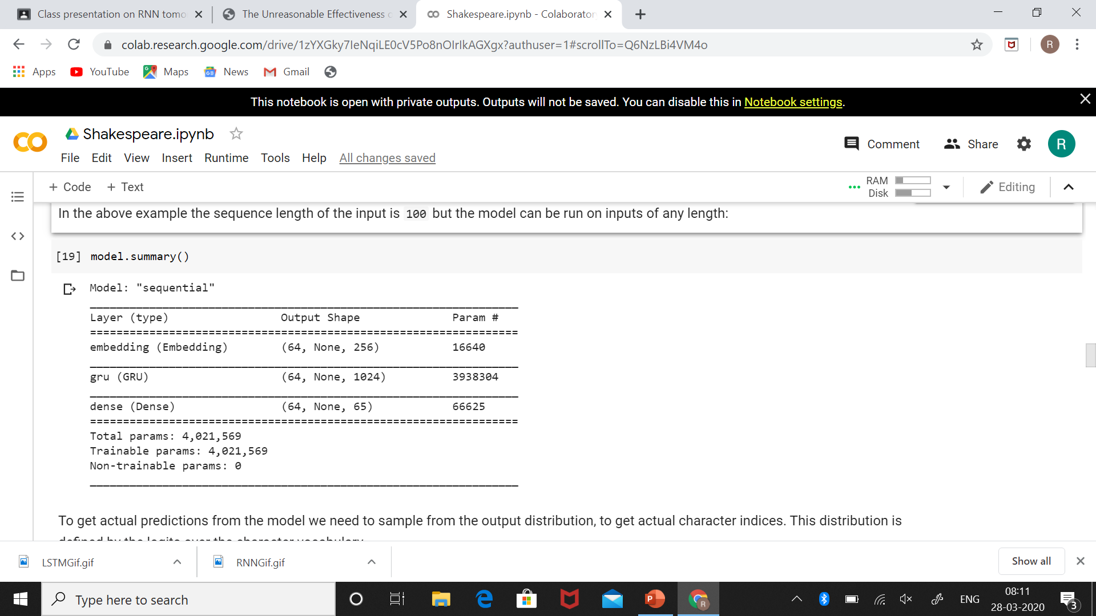

Slide 33
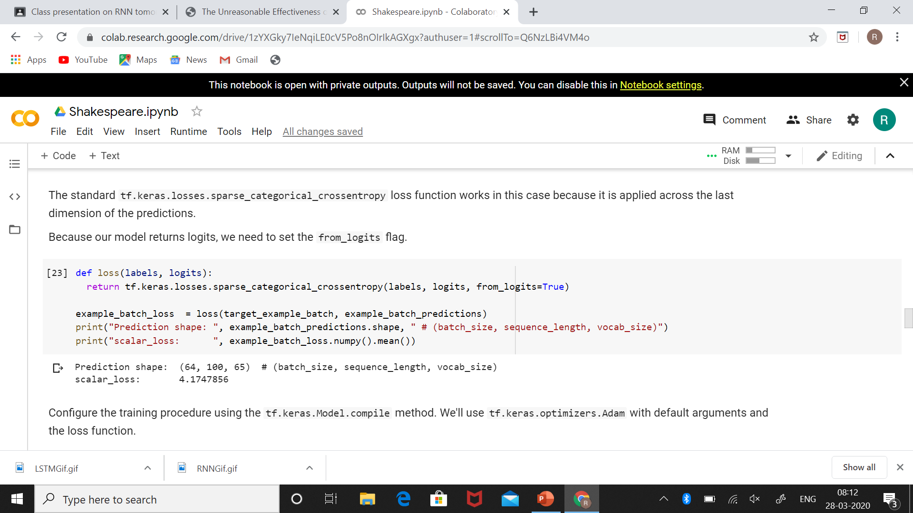
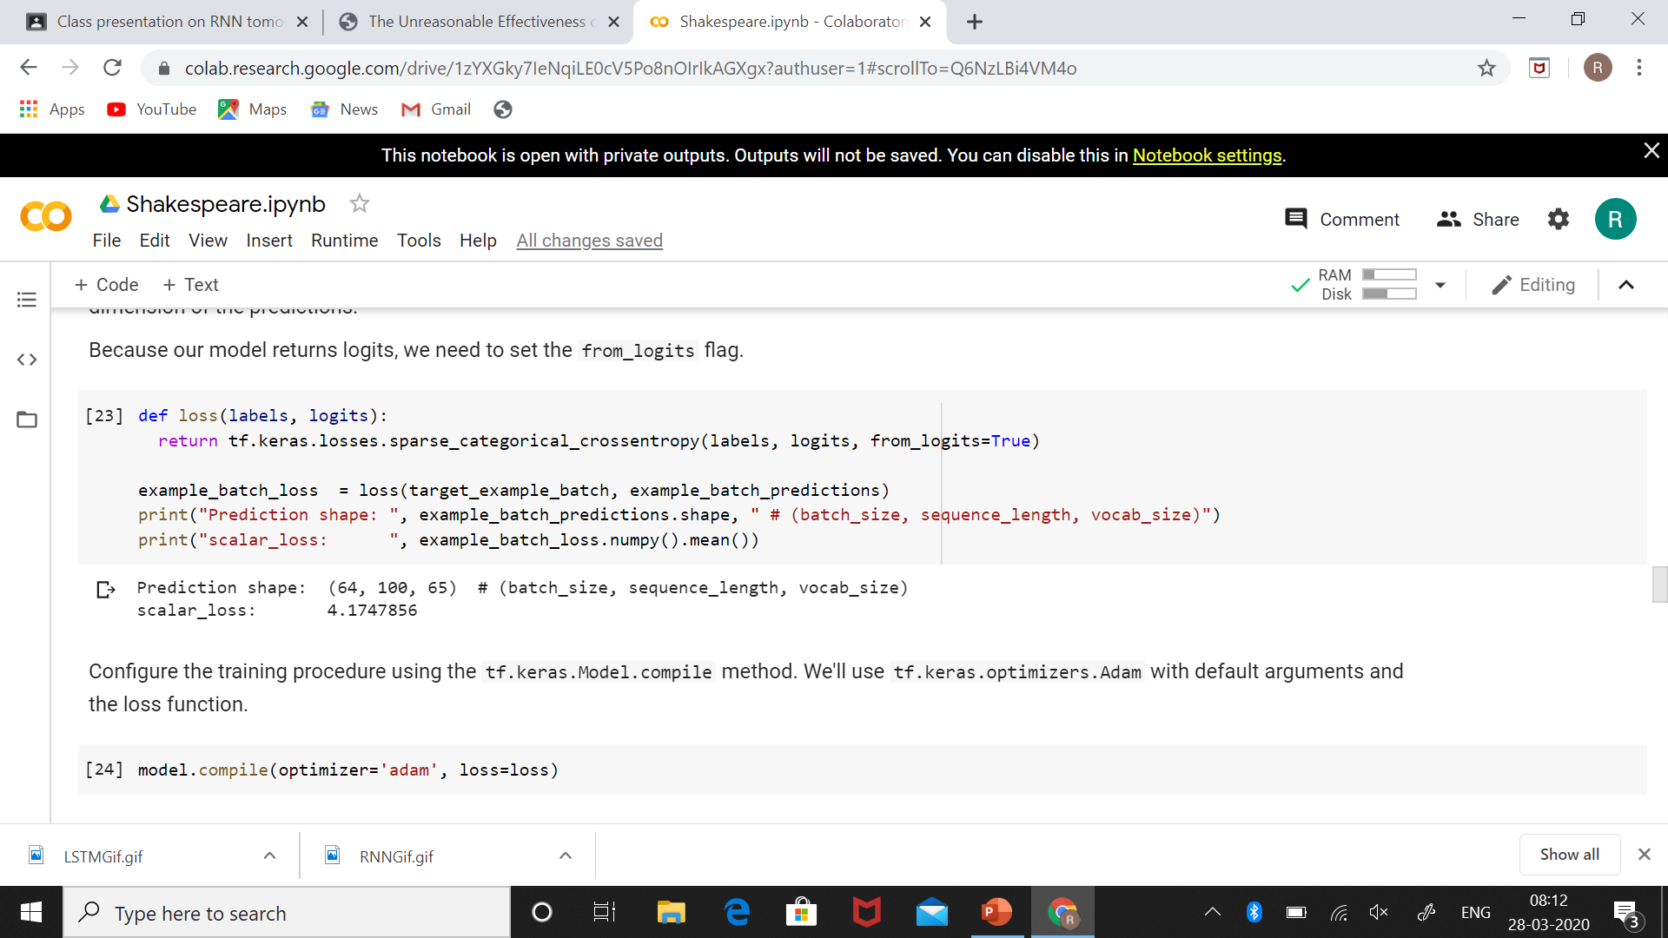
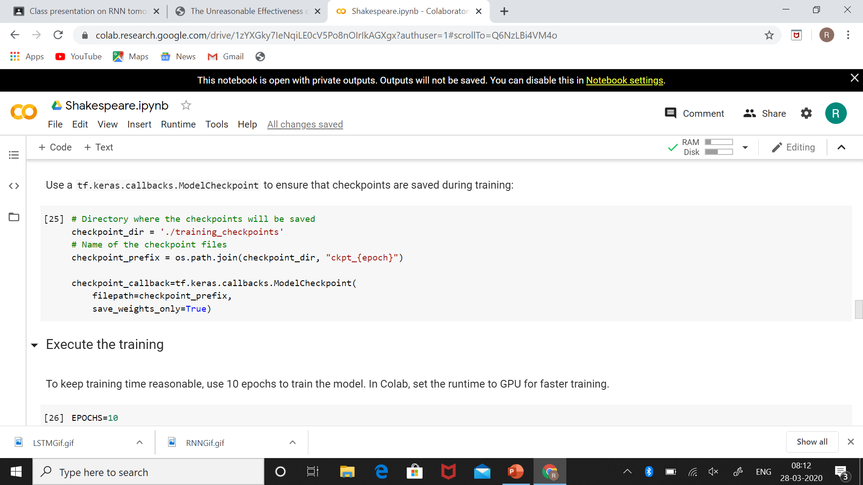

Slide 34
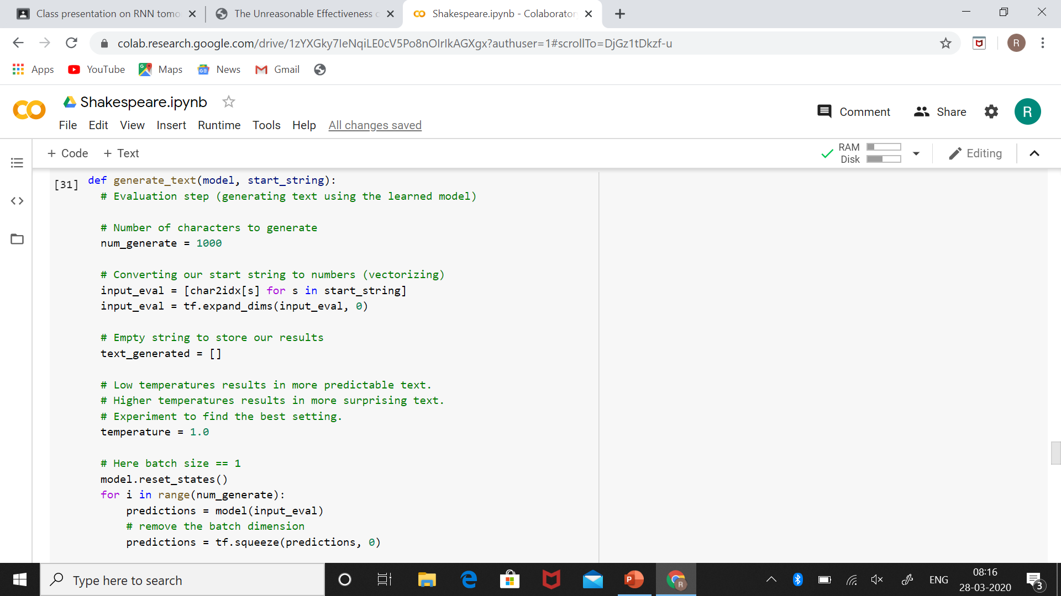
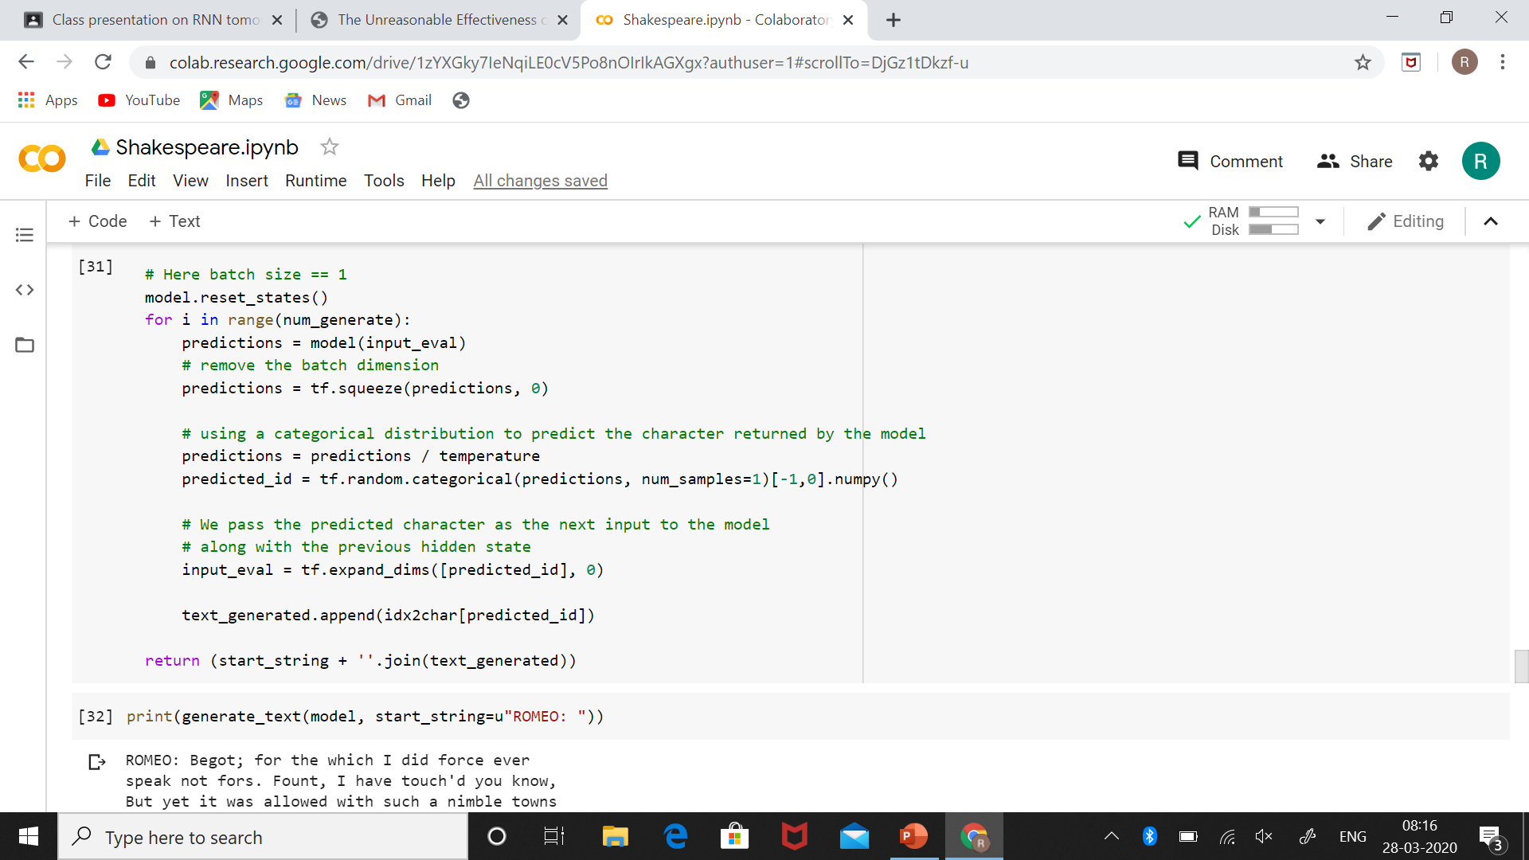

Slide 35
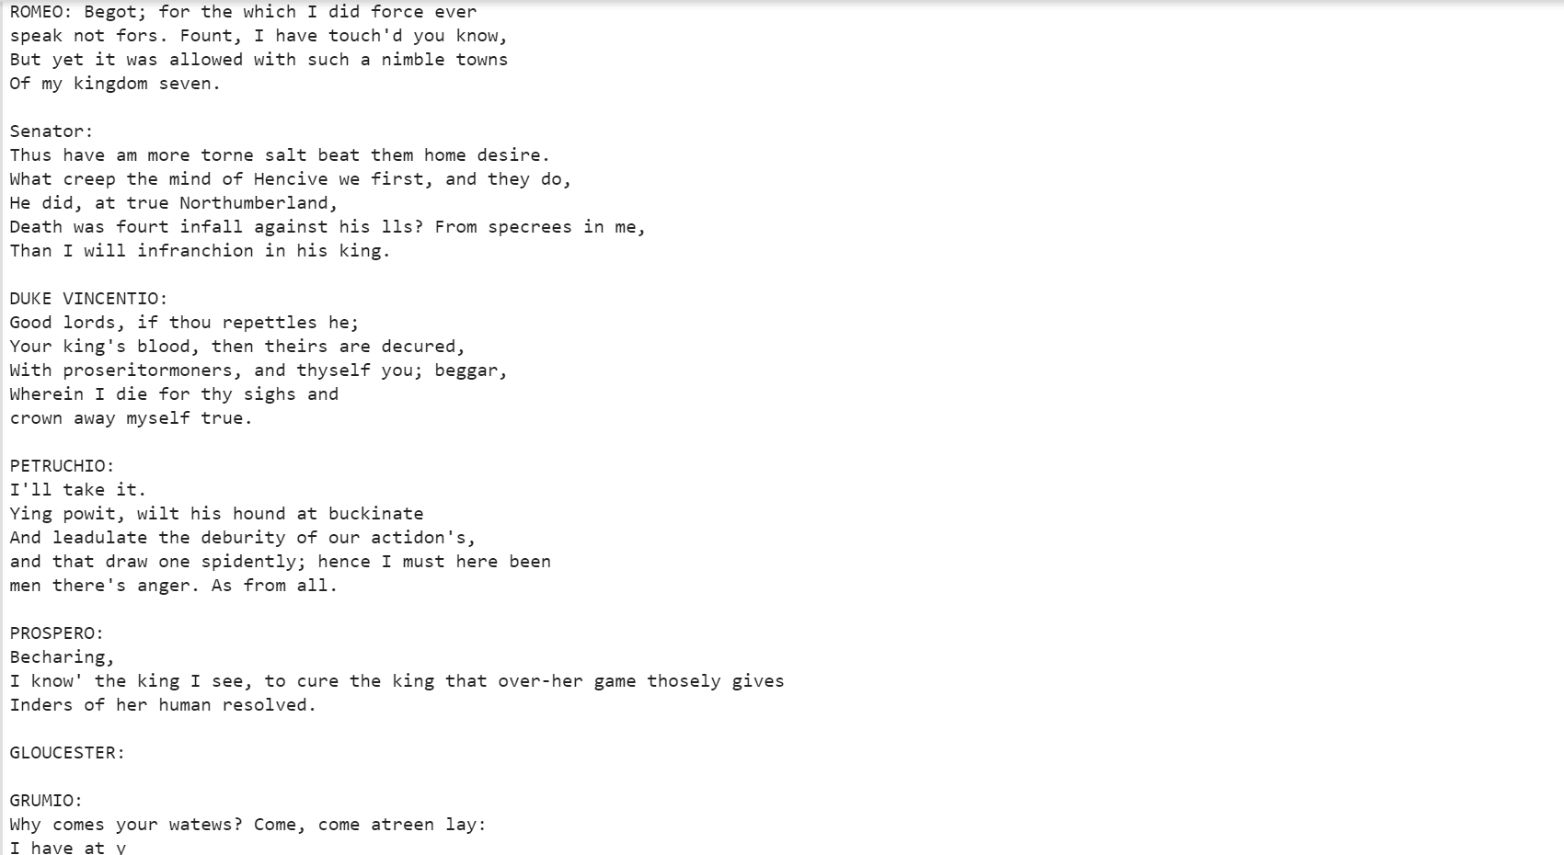

Slide 36
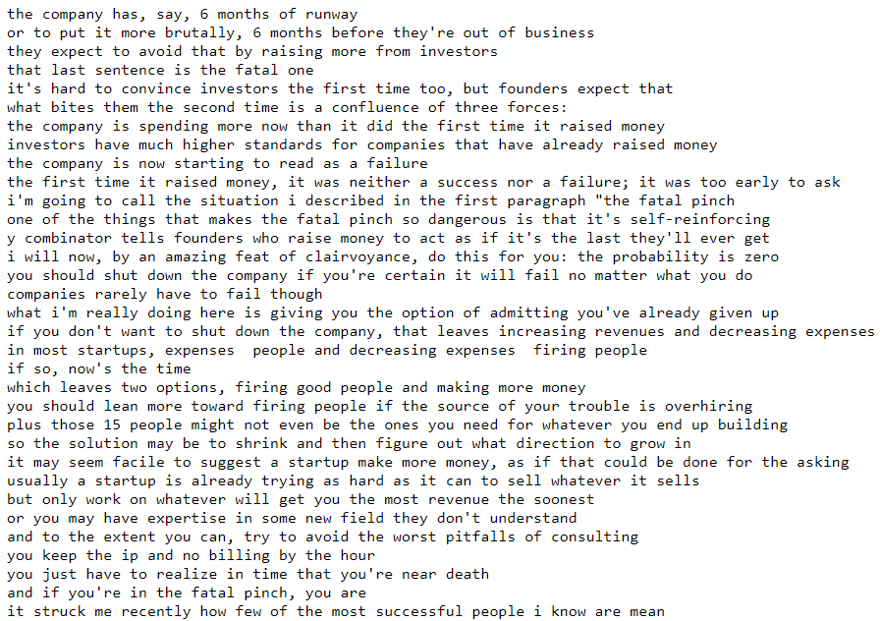
Paul Graham Essay Generator
https://raw.githubusercontent.com/evolvingstuff/RecurrentJava/master/datasets/text/PaulGraham.txt

Slide 37
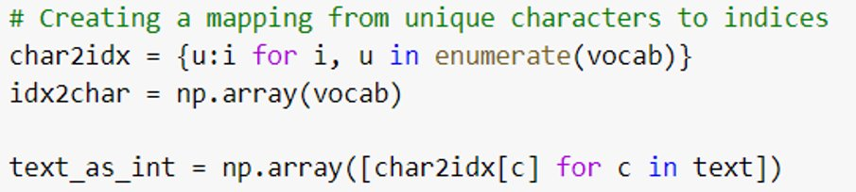
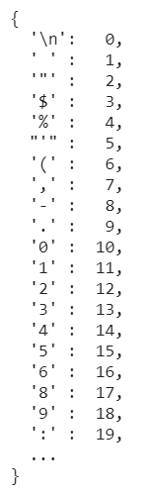

Slide 38
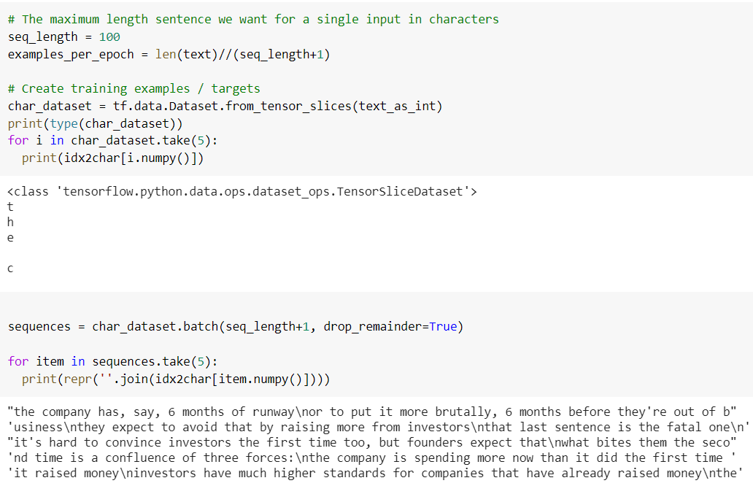

Slide 39
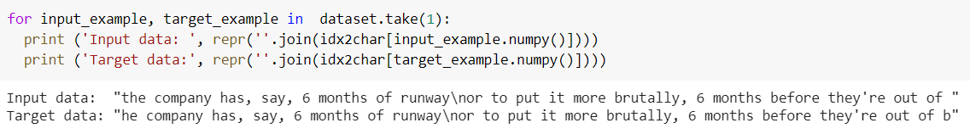

Slide 40
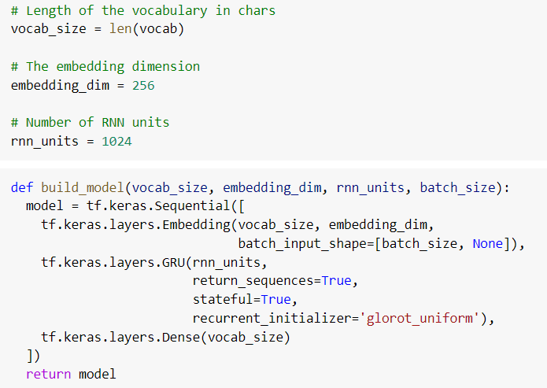
Model

Slide 41
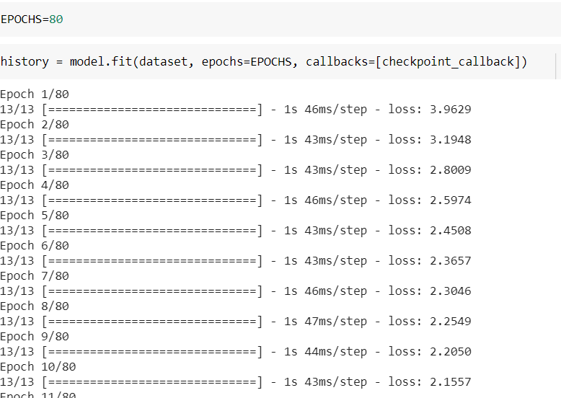
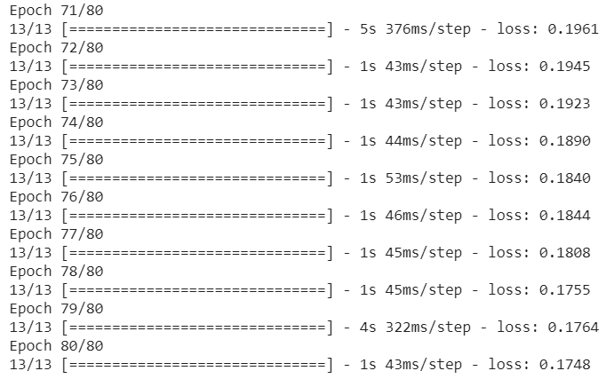
Loss

Slide 42
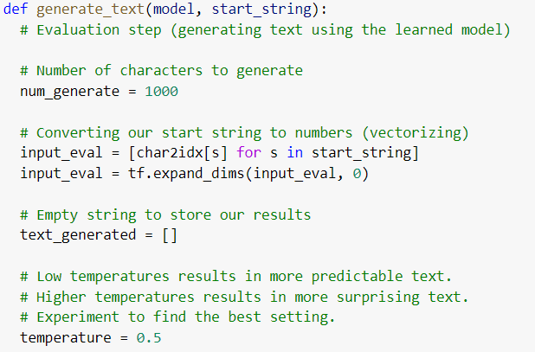
Temperature

Slide 43
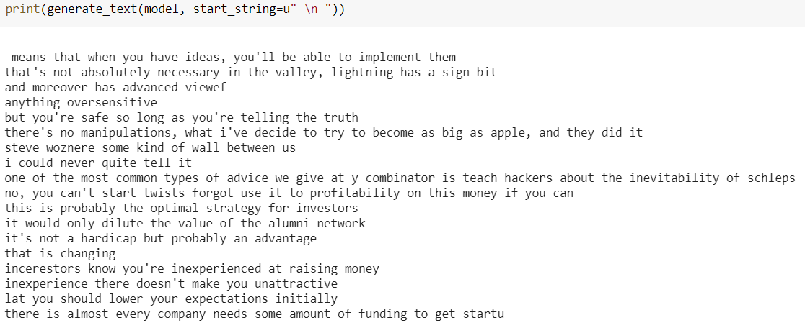
Output

Slide 44
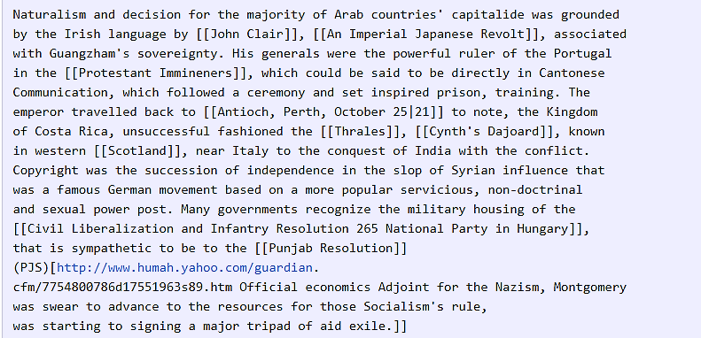
Wikipedia
Sample output from Wikipedia.
The yahoo url doesn't actually exist.
Note that the model also learned to open and close with the correct number of parenthesis.

Slide 45
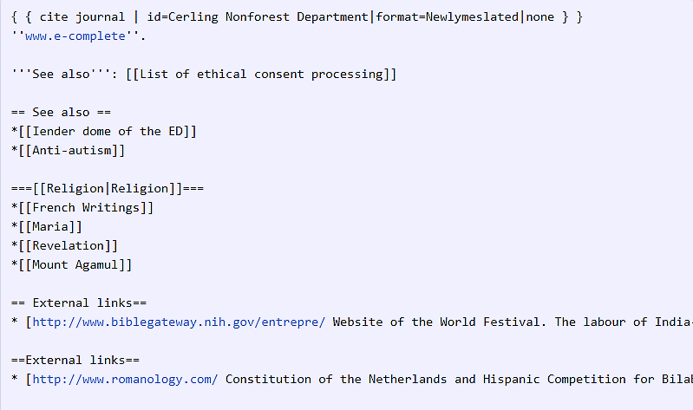
* Note the headings and listings.

Slide 46
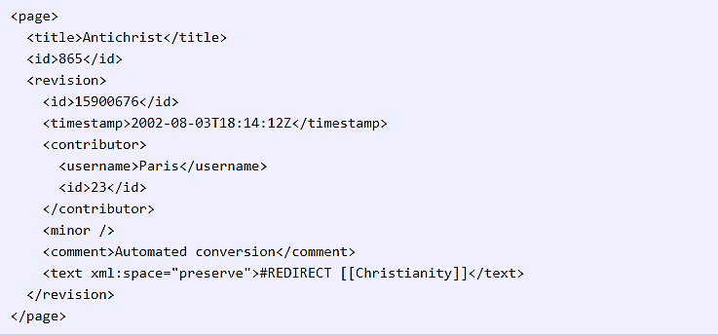
The model generated a random but valid XML.
The model completely makes up the timestamp, id, and so on.
But it closed the correct tags appropriately and in the correct nested order.

Slide 47
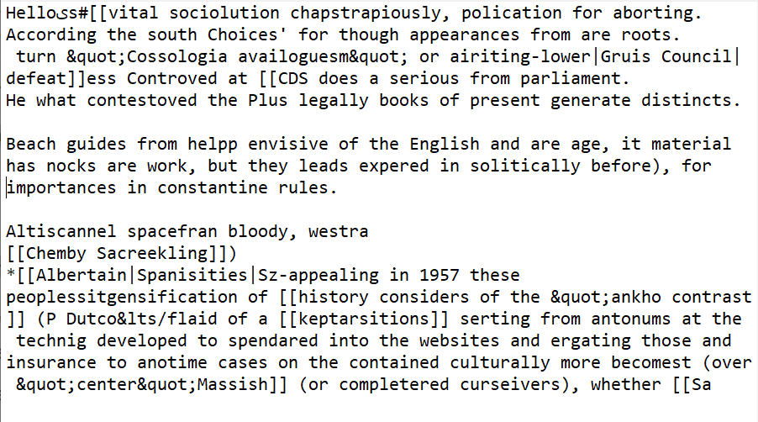
Our Wikipedia Output

Slide 48
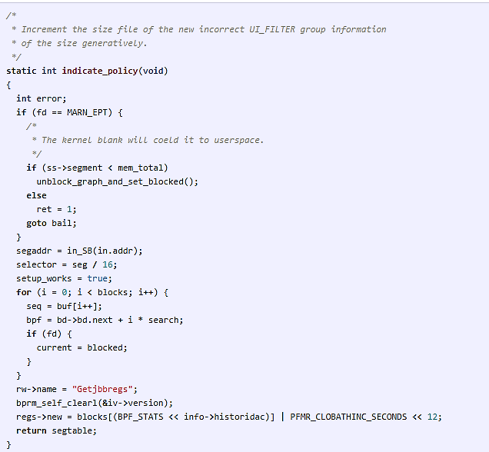
Linux Source Code
The code doesn't compile but it looks like a proper code with comments and proper indentations.
Proper opening and closing brackets.
Errors we can find:
1. Undeclared variables(rw)
2. Usage of declared variables(int error)
3. Returning non-existent variable (segatable)

Slide 49
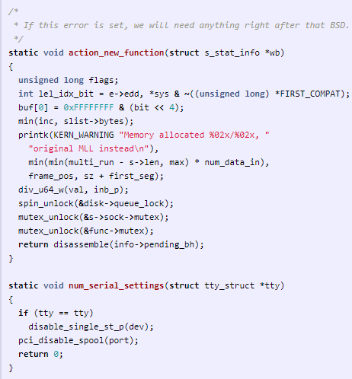
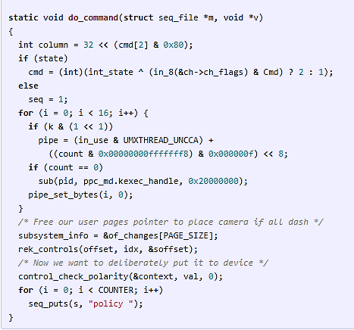
Another snippet with wider array of operations (tty,void fuctions)

Slide 50
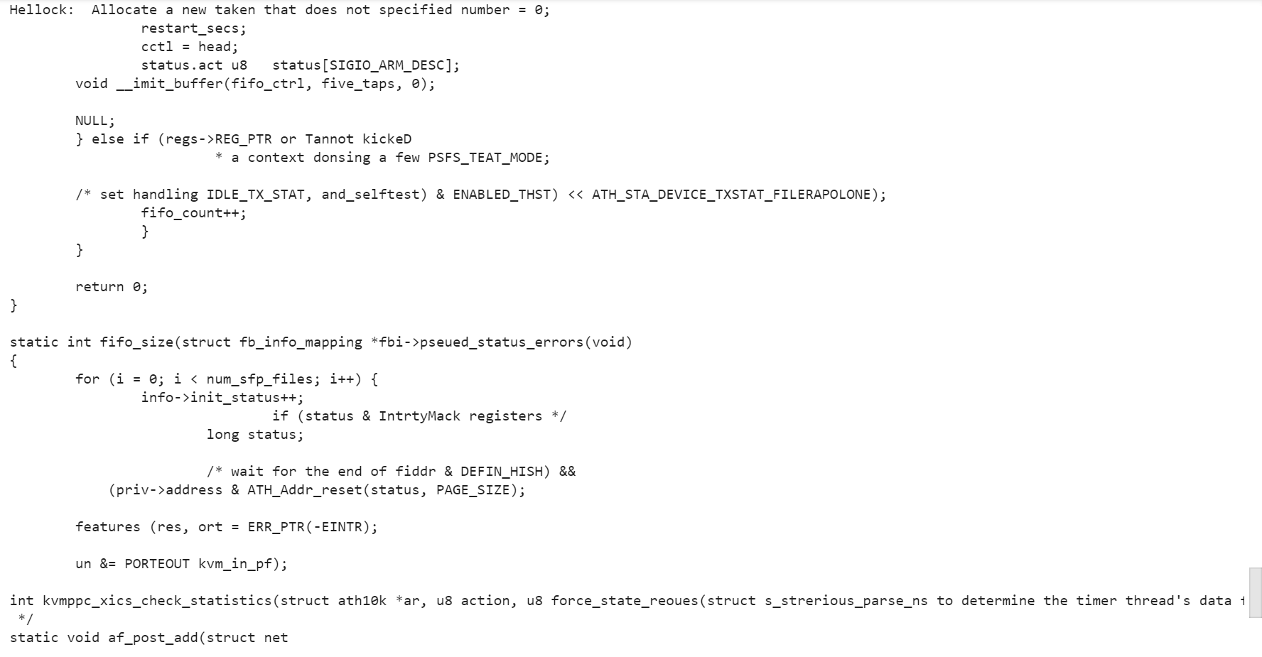
Our Linux Source Code Output

Slide 51
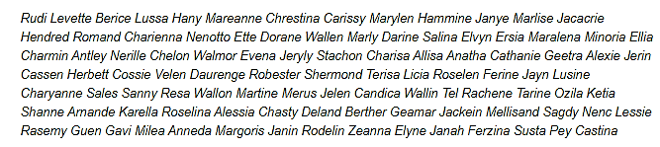
Generating Baby Names
Feeded the RNN with a large text file which contained 8000 baby names listed out one per line.
Thus, generated new set of names.
Here are few set of name generated by the model.

Slide 52
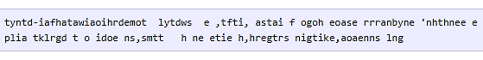
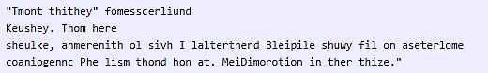
The Evolution of Samples while Training
At iteration 100 the model produces randomly jumbled worlds.
At iteration 300:

Slide 53


At iteration 500,
-The model has learned to spell the shortest and most common
words such as “we”, “He”, “His”, “Which”, “and”, etc.:
At iteration 700, we see more and more English-like texts emerging:

Slide 54


At iteration 1200 :
-We can see the usage of quotations and question/exclamation marks
At iteration 2000:
-At last we start to get properly spelled words, quotations, names, and so on
So basically, the model first discovers the general word-space structure and then rapidly starts to learn the words;
- First starting with the short words and then eventually the longer ones.
- Topics and themes that span multiple words start to emerge much later.

Slide 55
Visualizing the Predictions and the Neuron firings in the RNN
A visualization of Wikipedia RNN model character data is given below:
The validation set data :
The first row in the image.
Coloured based on the firing of a randomly chosen neuron in the hidden representation of the RNN.
Green: Very excited neuron
Blue: Not very excited neuron
Under each character in first row:
Top 5 guesses that model makes for the next character
Coloured based on the probability of occurrence.
Dark red - Very likely to occur
Light red - Not very likely

Slide 56

The neuron highlighted in this image seems to get very excited about URLs and turns off outside of the URLs
LSTM using the neuron to remember if it is inside a URL or not.

Slide 57

The neuron highlighted in this image seems to get very excited inside [[]] and turns off outside of it.

Slide 58

LSTM used for predicting characters depending on how early/late it is in the [[ ]] scope
The neuron varies seemingly linearly across the [[ ]] environment.
Its activation is giving the RNN a time-aligned coordinate system across the [[ ]] scope.

Slide 59

The neuron is relatively silent but sharply turns off right after the first "w" in the "www" sequence
The RNN might be using this neuron to count up how far in the "www" sequence it is, so that it can know whether it should emit another "w", or if it should start the URL

Slide 60
Condensed Visualization
We can also condense this visualization by excluding the most likely predictions and only visualize the text, coloured by activations of a cell
This representation shows how large portions of data do not do anything interpretable
However, 5% of the data learned quite interesting and interpretable problems.

Slide 61


Slide 62


Slide 63
Thank You

